Slide 1





START YOUR CAREER JOURNEY
WITH
ENTRYLAUNCH
Topic :-
Job Board Platform
Sujin Babu P S

Slide 2
ABOUT ENTRYLAUNCH
EntryLaunch is aimed at creating a platform for freshmen to avoid competing with experienced candidates.

Slide 3
MODULES
Admin
Candidates
employer

Slide 4
ADMIN
Platform management
Managing employer
View employer
Managing candidates
Content moderation
Skill enhancement programs

Slide 5
CANDIDATES
Profile creation
Job search
Save jobs
Application Status
Skill enhancement

Slide 6
EMPLOYER
Post/Remove job
View applications
Filter applications
Hiring process

Slide 7
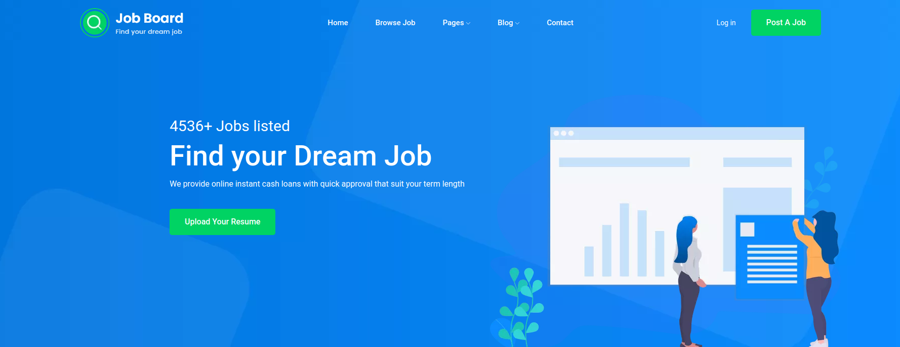
HOME PAGE

Slide 8
START YOUR CAREER JOURNEY
WITH
ENTRYLAUNCH
Topic :-
Job Board Platform
Sujin Babu P S

Slide 9
START YOUR CAREER JOURNEY
WITH
ENTRYLAUNCH
Topic :-
Job Board Platform
Sujin Babu P S

Slide 10
job deadline
serching the jobs
thank
you

